Slide 1

Games Research & Development Block 01 – Week 02

Slide 2
THIS WEEK











What have you found out about the projects briefs?
What questions to you have for the clients?








Slide 3
Last Week I asked for This Week
Come along with references, sources and ideas for ALL of the projects which interest you.
List of potential questions to the clients

Slide 4
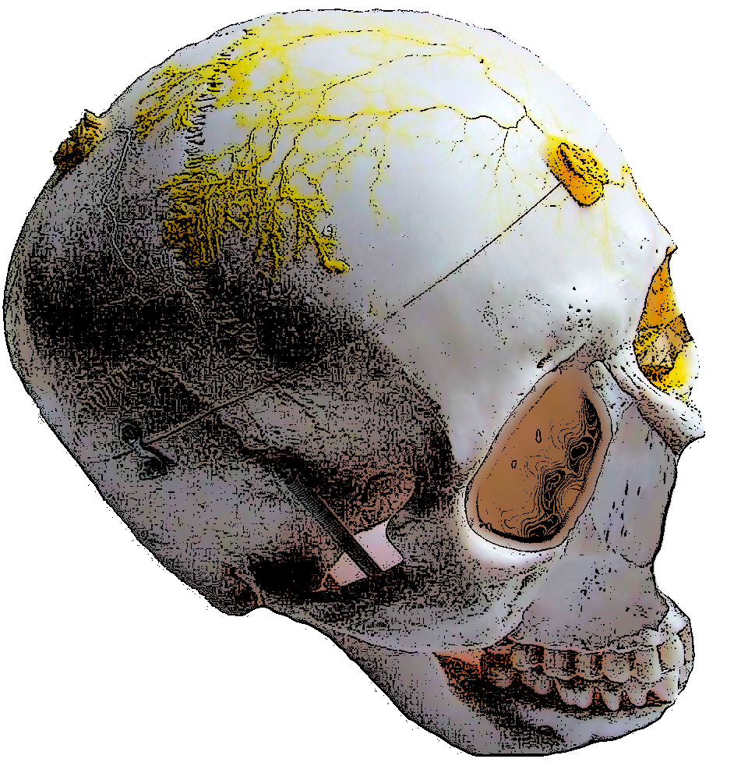
Slime
World One Powerful Presentation Template
Notes:
Background placeholder: After choosing your image, Right click on the image -> Send to back -> Click on send to back

Slide 5

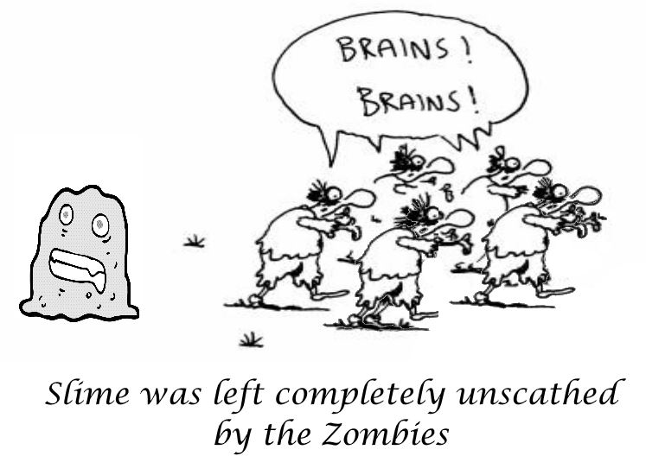
Unique fusion of living and digital technology
Rather than focusing on traditional laboratory based experimentation the PhySense project enables the general public (Citizen Scientists) to conduct biological experiments and share their experimental results. The PhySense website (https://www.physense.eu/) provides experiments which people can try. For example: which cereal does slime most enjoy for breakfast and how does slime solves a maze without a brain?
Slime is a giant single celled organism which physically moves through muscular contractions in its body. Monitoring the electrical signals associated with these contractions allows the organism's condition to be known. The electrical signals are amplified (by low cost electronics) and feed into home computers for analysis.
PhySense software (open source) calculates and tracks any changes in the frequency of muscular contractions. The results are graphically displayed for easy interpretation. For example: in steady conditions the frequency remains roughly constant. However, if slime is given food the frequency may increase. Being a living organism the slime reacts to most things, for example: light, vibration, chemicals, etc (not just food)!

Slide 6
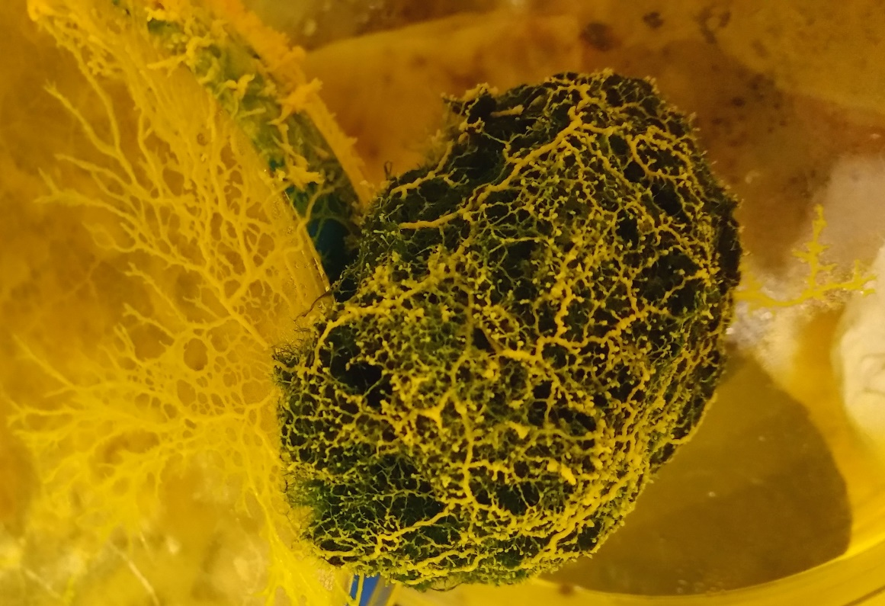
Your task (should you choose to accept it):
Create a game which demonstrates how intelligent and adaptable slime is when faced with harsh environment and deadly foes. Survival is no easy task, make a wrong decision and you quickly run out of options! For example: growing quickly requires more food but growing too slowly you might starve before finding new food.
In other words, the game could be sort of adaptive evolution based on real life. The player has to continuously adapt the slime to different conditions as it moves through the game. This would mean the game is 'fun' to play but also useful teaching resource (learning to balance the contradicting parameters of life).
Interestingly slime facts:
(1) slime can be split into two (or more parts) both of which can survive independently and merge back together to at later date
(2) to avoid wasting energy re-exploring areas (for feed) slime leaves a chemical trail so it knows where it has previously explored (this aids solving mazes)
(3) in harsh conditions slime can change into 'suspended dry state' and remain inactive for 30+ years, adding water reactivates growth in minutes
Animating drought - quinoa v potato
People can create their own slime experiments and share their findings via online database. The long-term goal is combine everyone’s measurements and allow unknown stimuli to be identified by searching the database for matching electrical signal (with known stimuli). In other words, create a living bio-sensor with many beneficial applications.

Slide 7
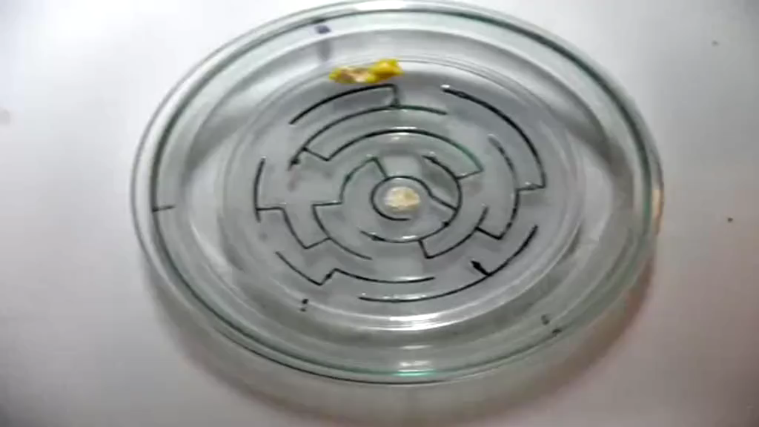
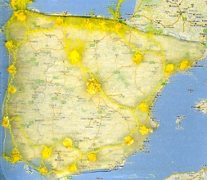

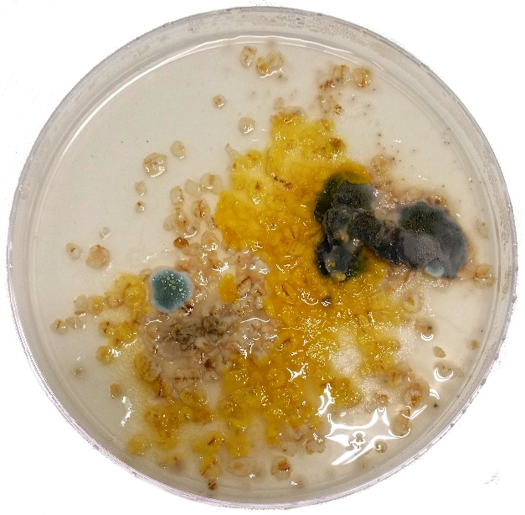
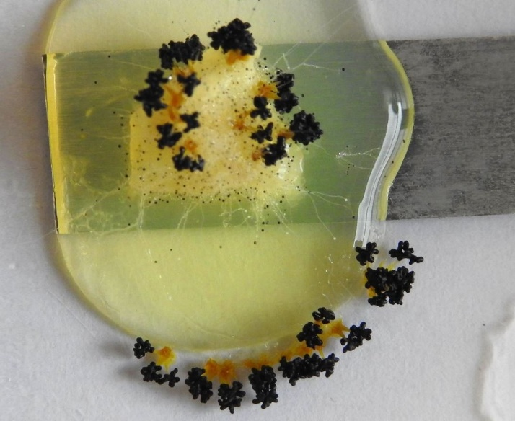
https://www.youtube.com/watch?v=75k8sqh5tfQ
Interdisciplinary team spanning: computing, electronics and biology
EU Horizon 2020 funding
Slime mapping Spanish road network
Slime versus infection for
Scottish oat flakes
Slime forming spores
Optionally, game could be multiple player if one player is slime and another player is 'infection'. For example, the infection can infect the slime and kill it. However, the slime can eat available food so the infection starves to death. A sort of Battle Royale between combatants with completely different skills and abilities.

Slide 8

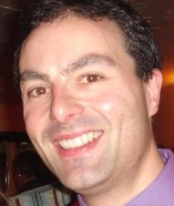
This
Task
Client…
Dr Neil Phillips
Unconventional Computing Laboratory
Things He’d Like…
Travel fast go alone, travel far go together …

Slide 9

AR Virtual Navigation
World One Powerful Presentation Template
Notes:
Background placeholder: After choosing your image, Right click on the image -> Send to back -> Click on send to back

Slide 10
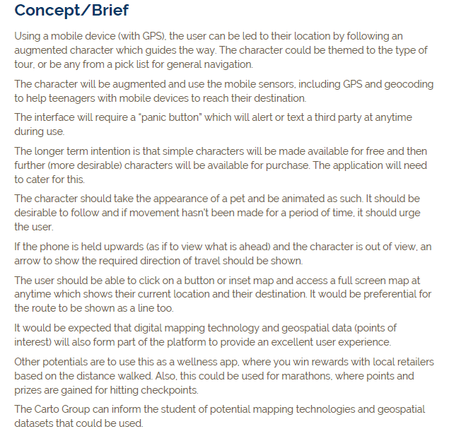


Slide 11
Cardiac
World One Powerful Presentation Template
Notes:
Background placeholder: After choosing your image, Right click on the image -> Send to back -> Click on send to back

Slide 12
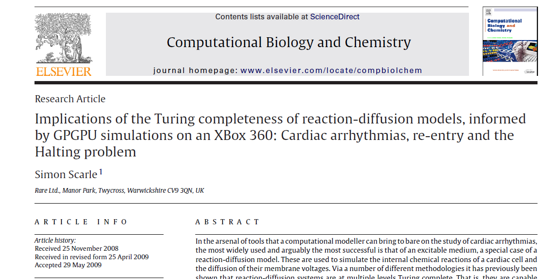
World One Powerful Presentation Template
Notes:
Background placeholder: After choosing your image, Right click on the image -> Send to back -> Click on send to back

Slide 13
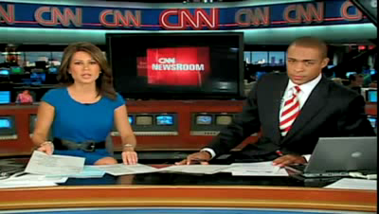
World One Powerful Presentation Template
Notes:
Background placeholder: After choosing your image, Right click on the image -> Send to back -> Click on send to back

Slide 14

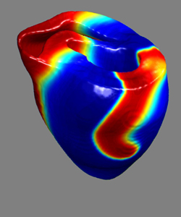
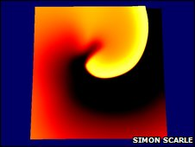

Cardiac Impact
AT BLOCK 1 – TASK 2
Your task:
A research group carrying out electro cardiology simulations want to add more impact for their next research proposal.
Games, AR and VR all seem to be quite sexy at the moments can they have some or preferably all of that please.
They are VERY particular that the underlying simulation they mainly use must in some way be implemented as part of this visualisation / game.
Some form of public performance /school out reach is quite important to them as well.
Some times a client knows they want or even need some kind of game / AR / VR element to improve the WOW factor of what they are doing.
However, often they have no real knowledge of what any of that means, what is possible, what prior art exists, and almost certainly what they want until you suggest / show them the preliminary work.
You then need to be flexible to achieve their aims, but at same time might need to guide them to think what those aims even are!
Notes:
Wireframe shader

Slide 15

This
Task
Client…
Dr Simon Scarle
Things They’d Like…
Cardiac system as public performance / interactive art work
But still linked back to the actual work done by the research group
Notes:
Progress Log
Components, rationale
Tutor logging
Average percentage mark

Slide 16
Nano
World One Powerful Presentation Template
Notes:
Background placeholder: After choosing your image, Right click on the image -> Send to back -> Click on send to back

Slide 17




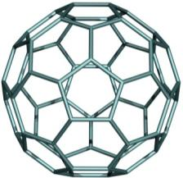
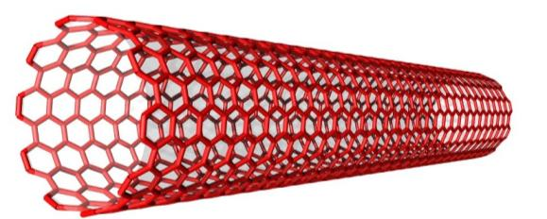
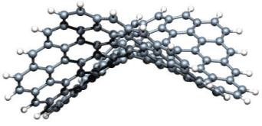
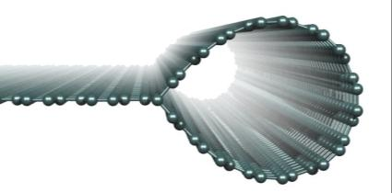
Action CA15107
WG2 : Theory and Modeling
Chris Ewels
Institut des Matériaux Jean Rouxel, Nantes

Slide 18

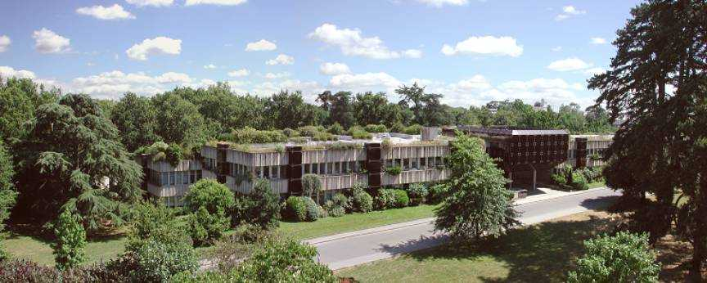
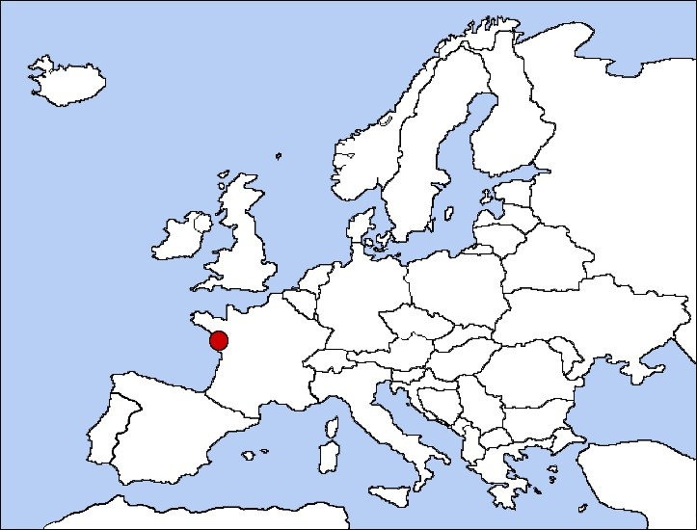
Institute of Materials
Nantes, France
IMN Nantes
Physics of Materials and Nanostructures Group (PMN)

Slide 19
Chopped out the theoretical modelling / science slides that went in here

Slide 20
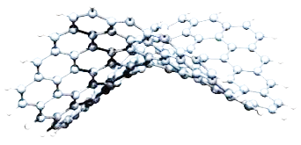
Outreach Possibilities
WG2 Theory and Modelling
New User Interfaces

Slide 21
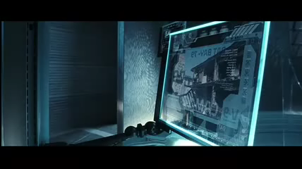
WG2 : New User Interfaces
2002: Minority Report

Slide 22

WG2 : New User Interfaces
2010: Iron Man 2

Slide 23
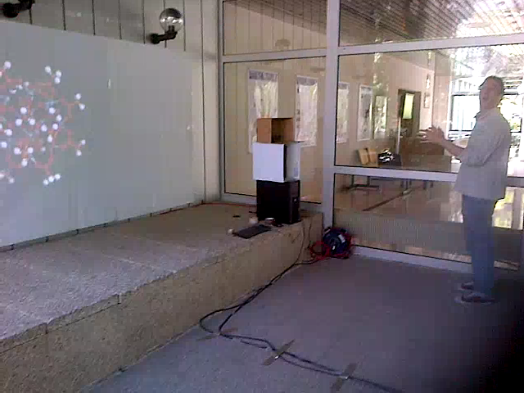
WG2 : New User Interfaces
2013: Institute of Materials Nantes

Slide 24
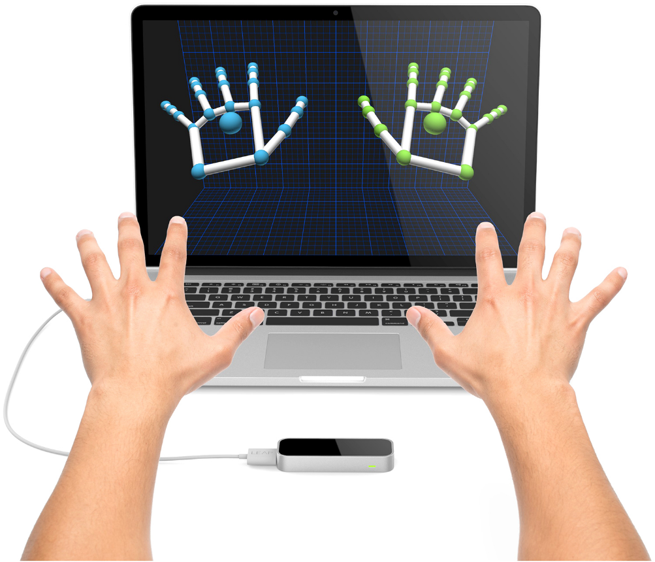
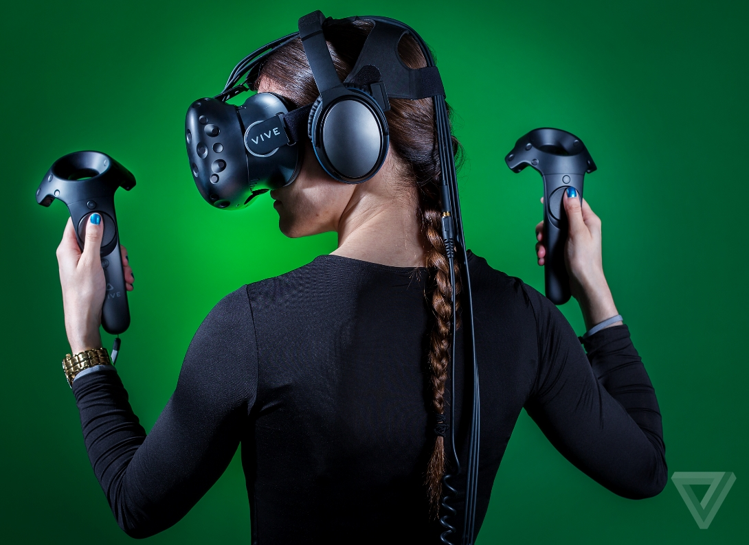

WG2 : New User Interfaces
Leap Motion
HTC Vive
Avogadro Demo
2017: Institute of Materials Nantes

Slide 25
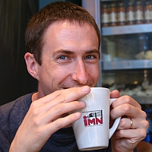
This
Task
Client…
Dr Chris Ewels
Institut des Matériaux Jean Rouxel, Nantes
Things He’d Like…
To interface with potentially standard molecular visualisation and modelling codes, examples are Avogadro, VMD and even jMol. Two aspects of the project:
Simpler first part is for visualisation in 3D of molecules, ideally isosurfaces or "clouds' around them representing electronic charge density, the quantum chemistry of the bonding in nanomaterials. (this is all data we can output from our density functional codes).
Secondary (but more useful!) part of the project would be to design a hands-free (e.g. leap motion) interface, again with standard software, allowing us to manipulate the molecules, crystals and nanomaterials in 3D, select atoms, bonds, or sections of the structure, move delete, rotate them through hand gestures.
To take the idea and direct it, instead of as a high-end research tool, towards low-end low-cost usage, e.g. through google cardboard, with the aim of developing an interactive 3D web-based public outreach system for schools and colleges to visualise nanomaterials and chemistry in 3D.
In the future I would prefer 1+2 as augmented reality rather than full immersion (again, more practical).
+jMol Mobile!
Notes:
Progress Log
Components, rationale
Tutor logging
Average percentage mark

Slide 26
PhysViz
World One Powerful Presentation Template
Notes:
Background placeholder: After choosing your image, Right click on the image -> Send to back -> Click on send to back

Slide 27


Visualising Software as a Particle System
Simon Scarle, University of the West of England
Neil Walkinshaw, University of Leicester

Slide 28
Visualisation Challenge
Software
Packages
Classes
Methods
Interfaces
Inheritance
Calls
Dependencies
Traces
Change history
Identifiers
Threads
…
Properties
LOC
NoM
NoC
Cyclomatic Comp.
Inheritance depth
Number of children
Fan-in/out
Code churn
Identifier proximity
Public methods
Attributes
…
Visualisation
Locations
Opacity
Colours
Edges
Nodes
Dimensions
Often not easily navigable – must fit within fixed constraints.

Slide 29
Visualisations for Specific Purposes
Goal
What do you want to achieve?
Question
What do you need to know?
Metric
What metrics will answer your questions?
How should the information be visualised?
Where are the “hot spots” in my system?
Need to visualise classes in terms of their activity …
… as specified by the number of incoming and outgoing calls.
Notes:
Choice of metrics is absolutely critical

Slide 30
PhysViz Data
Location Dimensions Mass Drag Gravity Colour Opacity
Width Strength Power
Colour Opacity
Input:
FAMIX MSE files,
Attribute mappings (JSON)
Output:
Navigable “game” Built upon DirectX
Properties
LOC
NoM
NoC
Cyclomatic Comp.
Inheritance depth
Number of children
Fan-in/out
Code churn
Identifier proximity
Public methods
Attributes
…

Slide 31
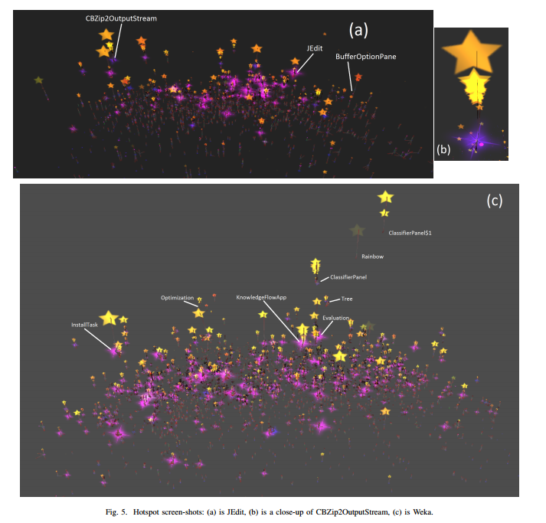

Slide 32
Asset Pipeline
Process to enable large teams of artists, designers, etc. to contribute efficiently.
Efficiently load large amounts of data into a game engine.
Minimise runtime processing.
Artist Input
Interim Build Format
Runtime Asset
Physviz Entities and relationships
Mapping
Artwork, motion, scripts,
Textures,
maps, AI, …
Intermediate representation
Stored in memory.
Data ready to be loaded into the Engine

Slide 33
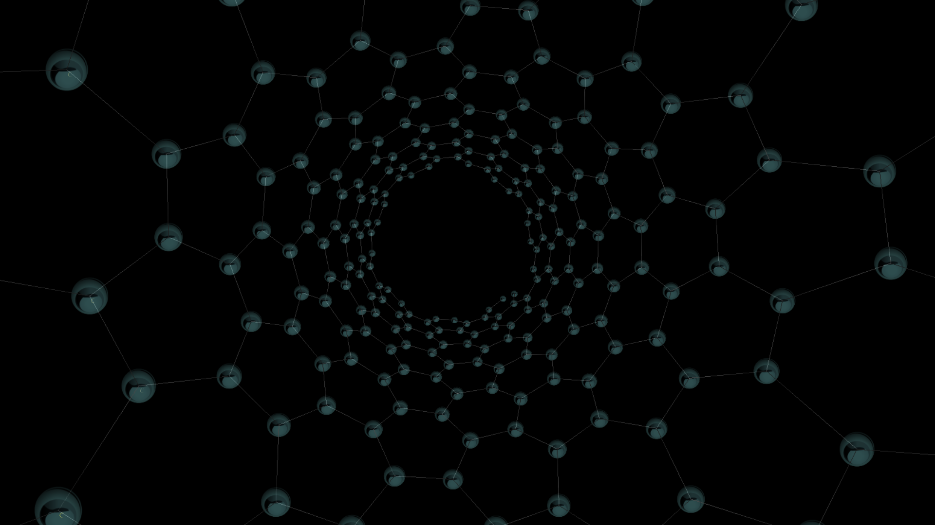

Slide 34
This
Task
Client…
Dr Simon Scarle
Things They’d Like…
Consolidate the new systems I’ve added with the ones Sam added
Find a more networks to visualise and ensure they fit within the frameworks given
Notes:
Progress Log
Components, rationale
Tutor logging
Average percentage mark

Slide 35
Autism and VR
World One Powerful Presentation Template
Notes:
Background placeholder: After choosing your image, Right click on the image -> Send to back -> Click on send to back

Slide 36
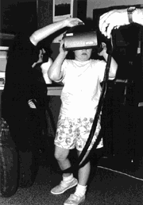

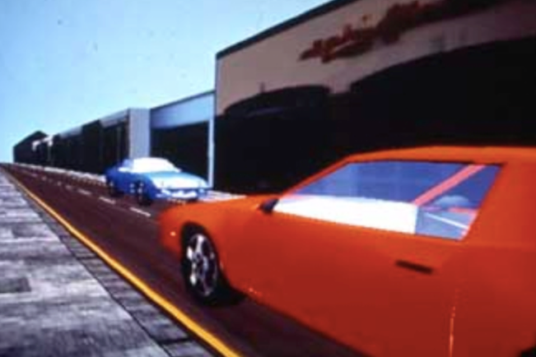
Opportunities for autistic people via VR
Background
Autism is a lifelong condition that represents challenges in social communication, restrictive interests and repetitive behaviours.
Intellectual abilities of autistic people may range from below average to above average.
It directly impacts about 1 in 66 people in the UK
Access to employment remains a significant problem for autistic groups with only 13% being employed
Issues with spotting danger (or dangerous situations) remains a problem for autistic groups (i.e. road safety)
Virtual Reality and Autism
First used in 1996 (see images above) with autistic people (in the US)
Has recently been tested again in both US and UK (Newbutt et al., 2016; Bradley and Newbutt, in press)
HMDs positively received by autistic communities (Oculus and HTC Vive)
Low negative effects and high sense of immersion / presence
Reduces stress/anxiety
Technology for Autism
Can be predictable and controllable
Not always socially complex or overly / unnecessarily complex
Can be less worrying / stressful for some
A space to ‘test’ and therefore remove stresses associated with real-life consequences
Often a one-2-one interaction; less complex information to process/deal with
Notes:
Wireframe shader

Slide 37
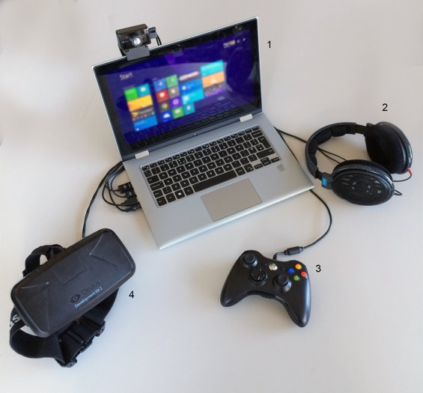
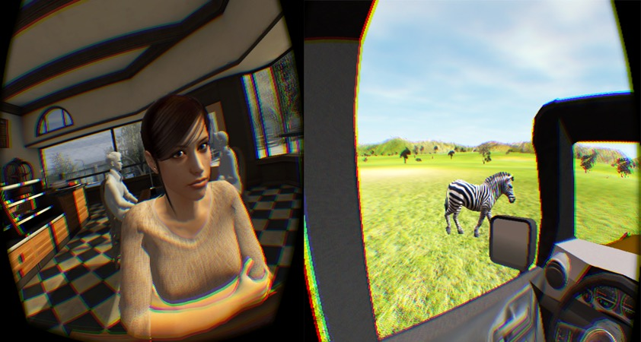
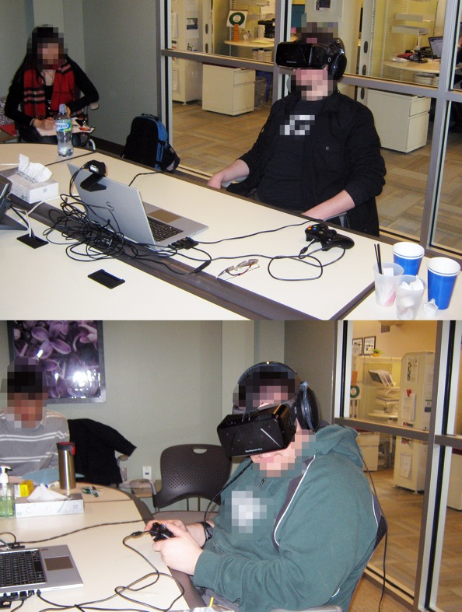
Current work
Results so far highlight
Willingness to wear equipment
Use input and navigate basic scenes
Use bodily interactions in response to the VE
Self-reported high level of presence, immersion and feeling natural in the space
Low level negative effects
Both higher/lower (respectively) than more traditional VE interfaces
Anxiety not increased as a pre-post test after HMD VRT experience
What we don’t have
High quality content that is specifically focused towards skills development
Immersive content that could improve the outcomes for this underrepresented group
Deployment in spaces that could maximise the uptake of VR (i.e. schools, homes)
Development teams to support this innovative work and help produce content
Options to scale
Notes:
Wireframe shader

Slide 38
This
Task
Client…
Dr Nigel Newbutt
UWE, Department of Education
Things They’d Like…
An environment that can develop some key skills in autistic groups
Use VR as a way to support and provide access to lifelong skills
Improve outcomes for autistic groups
Use VR as a way to test and try things out, for example:
Road crossing skills, social skills, interview skills, making friends, going to get a coffee, etc…
Using state of the art technology (HTC Vive or Oculus Go; we have both)
Notes:
Progress Log
Components, rationale
Tutor logging
Average percentage mark

Slide 39
Rain
World One Powerful Presentation Template
Notes:
Background placeholder: After choosing your image, Right click on the image -> Send to back -> Click on send to back

Slide 40


Slide 41

Peter’s Request Block Intro - Task 01
Your task:
Your team’s lead designer has been let out the building and gone to some game development event without his chaperone and has come back fizzing with ideas.
In particular they are really excited by the particle effects of this cool game by Acquire
https://en.wikipedia.org/wiki/Rain_(video_game)
He doesn’t like the fact they use models for the main characters though.
PARTICLES ALL THE WAY!
He’s also really impressed by the “built in engine” of some “new platform” that he’s really excited for the team to start working with.
Particles for “Rain” effects
Taking a, shall we say, incomplete idea from your design team and making that into solid tech is an important skill near the start of a more complex game project.
However, a little knowledge can be dangerous and sometimes your job might be to say “No that method won’t work” and suggest (and ideally show) workable alternatives.

Slide 42
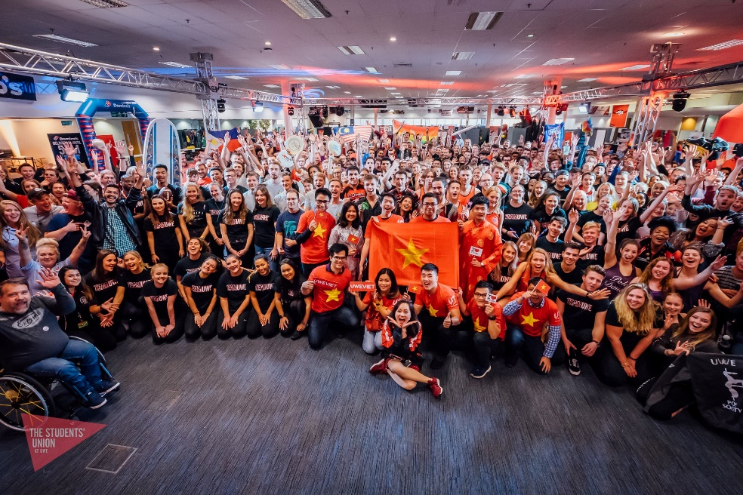


The Students’ Union at UWE
Engaging Students across UWE
Will Hoskin
Representation Manager

Slide 43
The Students’ Union at UWE’s mission is to be an award winning nationally recognised students’ Union that our member can be proud of.
To that end we are looking to engage with students who do not traditionally engage with us, often this would be students who are “hard to reach”.
Student carers, International Students, Mature Students, Distance Learners, Partner College students
Our aim is to increase awareness of The Students’ Union and what we do for students so that students know who we are and what we can support them with.
www.thestudentsunion.co.uk/
Is it new ways for students to engage with our services via a Virtual Tour? Is it a bespoke app that signposts students to our services based on a brief survey? Using our Brand guidelines we would like to find a way to engage with one or more of the harder to reach student groups above.
www.thestudentsunion.co.uk/brand/

Slide 44
Next Week
One/Two page outline proposal
Intro
Base Research
High-level deliverables
How TEST the systems produced?
Outline of the One-Note we’ll be using
These proposals will be the first documents you probably will post there

Slide 45
There After
Until Christmas:
Mainly planning for the New Year but also preliminary Implementation
Writing of a fuller proposal / research plan, test plan and setting of milestones with myself and client

